Slide 1

PARK OVER
Detailed Software Requirements Specification for the Car Parking App.

Slide 2
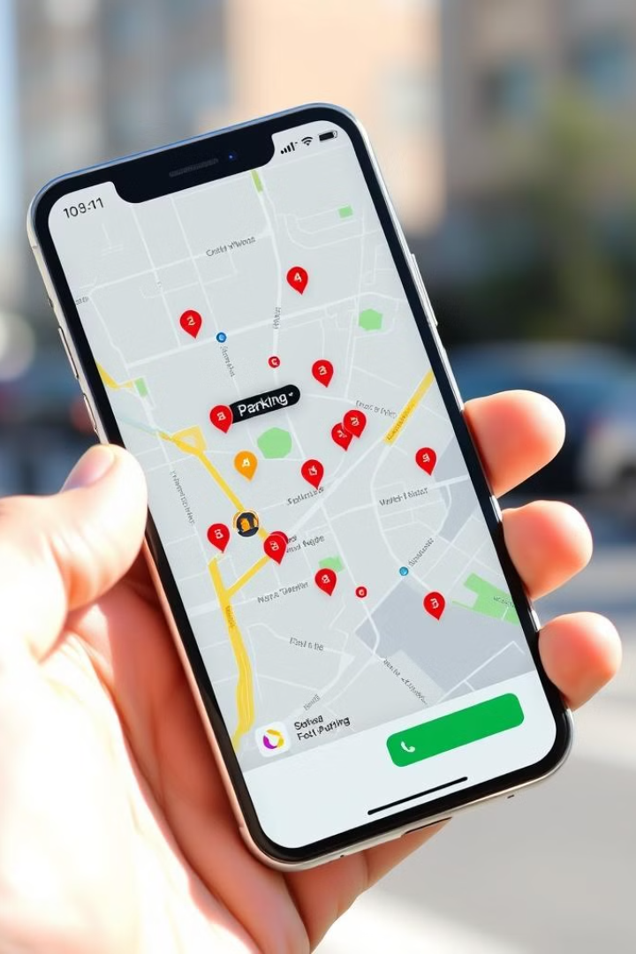
App Purpose
Provides a seamless parking experience for users.
Booking
Book parking spaces.
Availability
View real-time availability.
Management
Manage bookings.

Slide 3

App Scope
Secure platform for booking parking spaces.
1
Real-time Tracking
Track availability.
2
Secure Payment
Secure payment gateway.
3
QR Code Entry
QR code-based entry/exit.
4
Admin Dashboard
Manage spaces and bookings.

Slide 4
App Interfaces
Interfaces with third-party payment gateways and external databases.
User Interface
Admin Interface
Booking and managing parking.
Managing parking slots and monitoring user bookings.
App User Characteristics
Individuals looking to book parking spaces.
End Users
Administrators
Individuals looking to book parking spaces.
Parking facility managers.

Slide 5
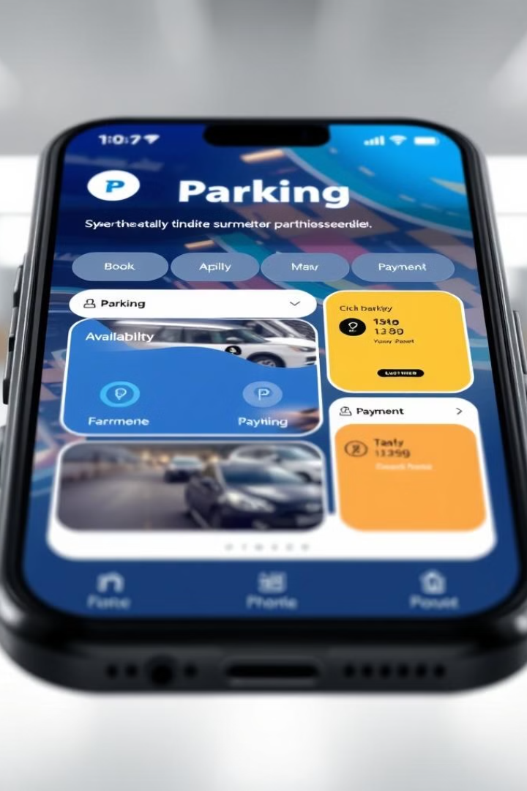
App Features
Intuitive UI for easy parking booking.
1
Real-time Availability
View and book available slots.
2
Secure Payment
Integration with payment gateways.
3
Booking History
Access and manage bookings.
4
Admin Dashboard
Manage parking slots and user bookings.

Slide 6
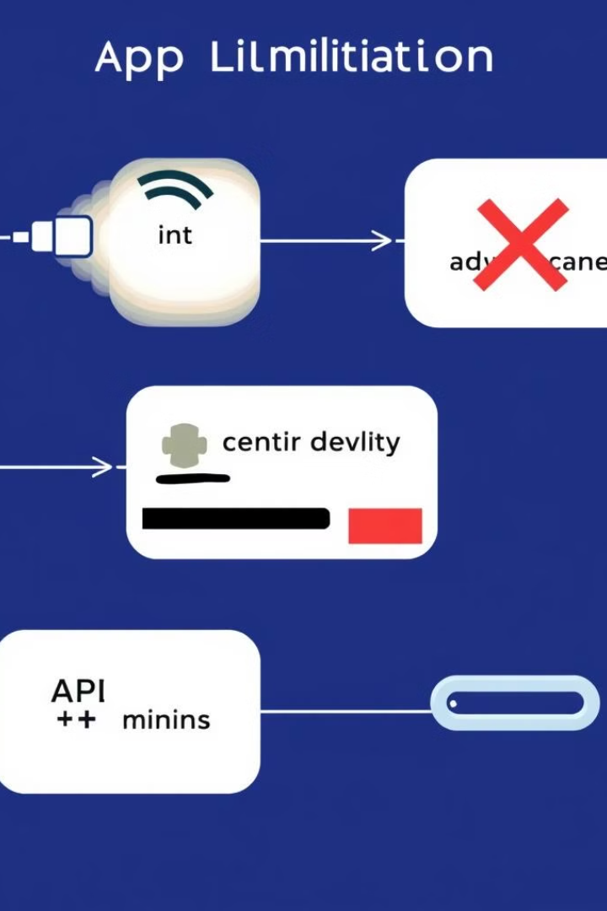
App Constraints
Internet connection required for booking, payments, and real-time updates.
1
Integration
Integration with third-party payment gateways.
2
API Limitations
Possible API limitations.

Slide 7
App Functional Requirements
The system must allow users to register using an email ID and password.
1
Registration
Users can register using an email ID and password.
2
Parking Slot Booking
Users can search for available parking slots based on location.
3
Payment Processing
The app will integrate with payment gateways.
4
Booking History
Users can view their past bookings.
5
Push Notifications
Notifications will be sent to users.
6
QR Code-Based Entry/Exit
A QR code is generated for users to scan.
7
Admin Dashboard
Admins can add, edit, and delete parking spaces.

